Slide 1
OvS-DPDK Acceleration with rte_flow: Challenges and Gaps
December 10-11, 2019 | Westford, MA
Dr. Hemal V. Shah and Sriharsha Basavapatna, Broadcom Inc.

Slide 2
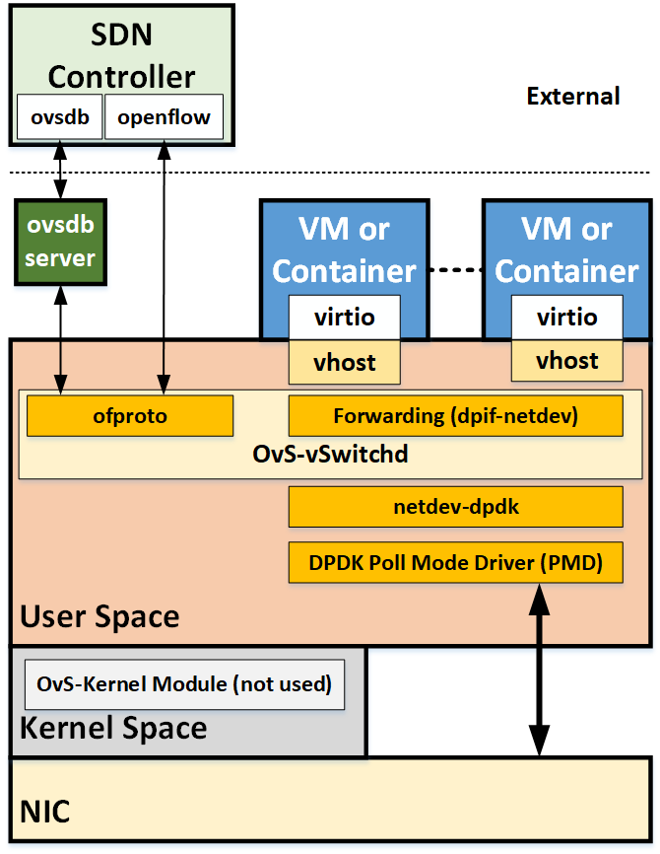
OvS-DPDK Acceleration Architecture Gaps
Offload capability – missing discovery
rte_flow_validate: to validate a flow for offload
Issues: extra operation, lack of specific error info
OvS-DPDK does not even use rte_flow_validate
Need to optimize design for capability discovery
Challenges with offload on vhost-user port
Actions offload is not supported for ingress flows
Software lookup is needed for egress flows
Actions offload is also not supported for egress flows
DPDK VF Representor (VF-Rep) management plane
CLI or management I/F – does not exist
VF creation/destruction is outside of DPDK environment
PF PMD can’t be used for VF management
Vendor specific creation/destruction of VF-Rep
A possible fix: dedicate a VF PMD for VF-Reps mgmt

Slide 3
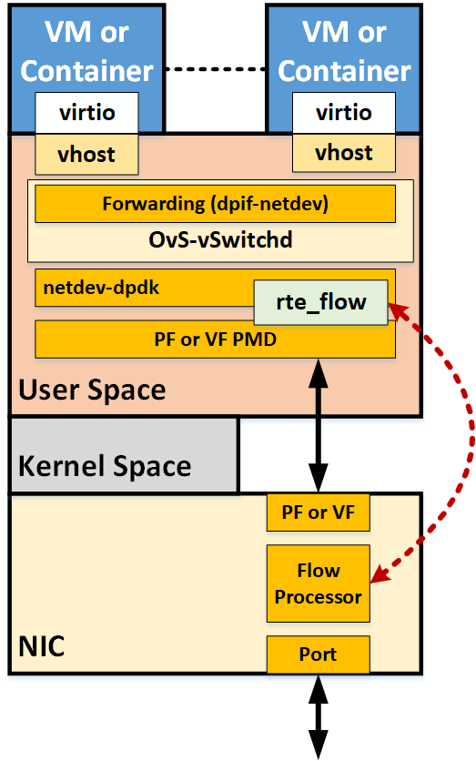
OvS-DPDK Acceleration Implementation Gaps
Actions Offload (partial and full)
Supported: MARK, RSS
Not supported: OUTPUT, DROP, COUNT, VF, ENCAP, DECAP, METER, etc.
Control Plane APIs
Supported: Add, Delete
Not supported: Dump, Flush, Stat
Recent full offload patches try to address this
No error reporting for offloaded flows
Need to refine

Slide 4
Other OvS-DPDK Offload Considerations
Dynamic Rebalance – does not exist, needed for capacity mgmt.
Kernel and user/dpdk datapath differ w.r.t offloads
kernel/tc : flow added to either DP or HW
dpdk: flow added to both DP and HW
Impacts dynamic rebalancing logic – need consistency
Leverage Out-Of-Resources (ENOSPC) error reporting from PMDs
Need error propagation from dpif-netdev back to ofproto-dpif
Openstack/OVN Integration …
Let us advance and improve OvS-DPDK acceleration/offload.

